Slide 1
QA Test Strategy Presentation
Comprehensive approach to software quality assurance
Notes:
AI-generated content may be incorrect. ---

Slide 2
QA Strategy — WHY
Notes:
Purpose of QA Strategy

Slide 3

Purpose of QA Strategy
Ensure Accurate Pricing
QA strategy guarantees customers receive correct pricing to prevent payment errors and disputes.
Inventory Visibility
Provides clear visibility into inventory to avoid synchronization failures and stock issues.
Reliable Fulfillment Process
Reduces risks of flawed order fulfillment, protecting business reputation and customer satisfaction.
Support Safety-Critical Products
Prevents errors that could impact product quality and safety for motorcycles and accessories.
Notes:
The QA Strategy aims to ensure that customers receive accurate pricing, visibility into inventory availability, and a dependable ordering experience for motorcycles, gear, and accessories. It reduces risks associated with incorrect payments, failed inventory synchronization, and flawed fulfillment processes that could negatively impact business reputation and customer satisfaction. Additionally, the strategy supports the safety-critical nature of the products by preventing errors that could affect the quality or suitability of delivered items.

Slide 4
Test Approach (Principles & Levels)
Notes:
Principles, Test Levels

Slide 5

Principles
Fast Feedback Testing
Testing maximizes feedback speed by validating logic at unit and API levels with pull request checks in ten minutes.
Architecture-aligned Testing
Testing aligns to architectural boundaries to detect defects across frontend, backend-for-frontend, and backend services effectively.
Risk-based Prioritization
Testing prioritizes critical areas like pricing accuracy, inventory, payment flows, and accessory compatibility based on risk.
Selective End-to-End and Integration
End-to-end tests focus on purchase-critical flows; integration tests ensure reliable payment and warehouse processes.
Notes:
Testing principles focus on maximizing feedback speed by validating logic at the unit and API levels, enabling pull request checks within ten minutes. Testing is aligned to architectural boundaries to efficiently detect defects across the frontend, backend-for-frontend, and backend services. A risk-based approach prioritizes high-impact areas such as pricing accuracy, inventory handling, payment flows, and accessory compatibility. End-to-end tests are reserved for purchase-critical flows due to staging environment limitations. Integration tests ensure that key processes, such as payment provider interactions and warehouse synchronization, function reliably.

Slide 6
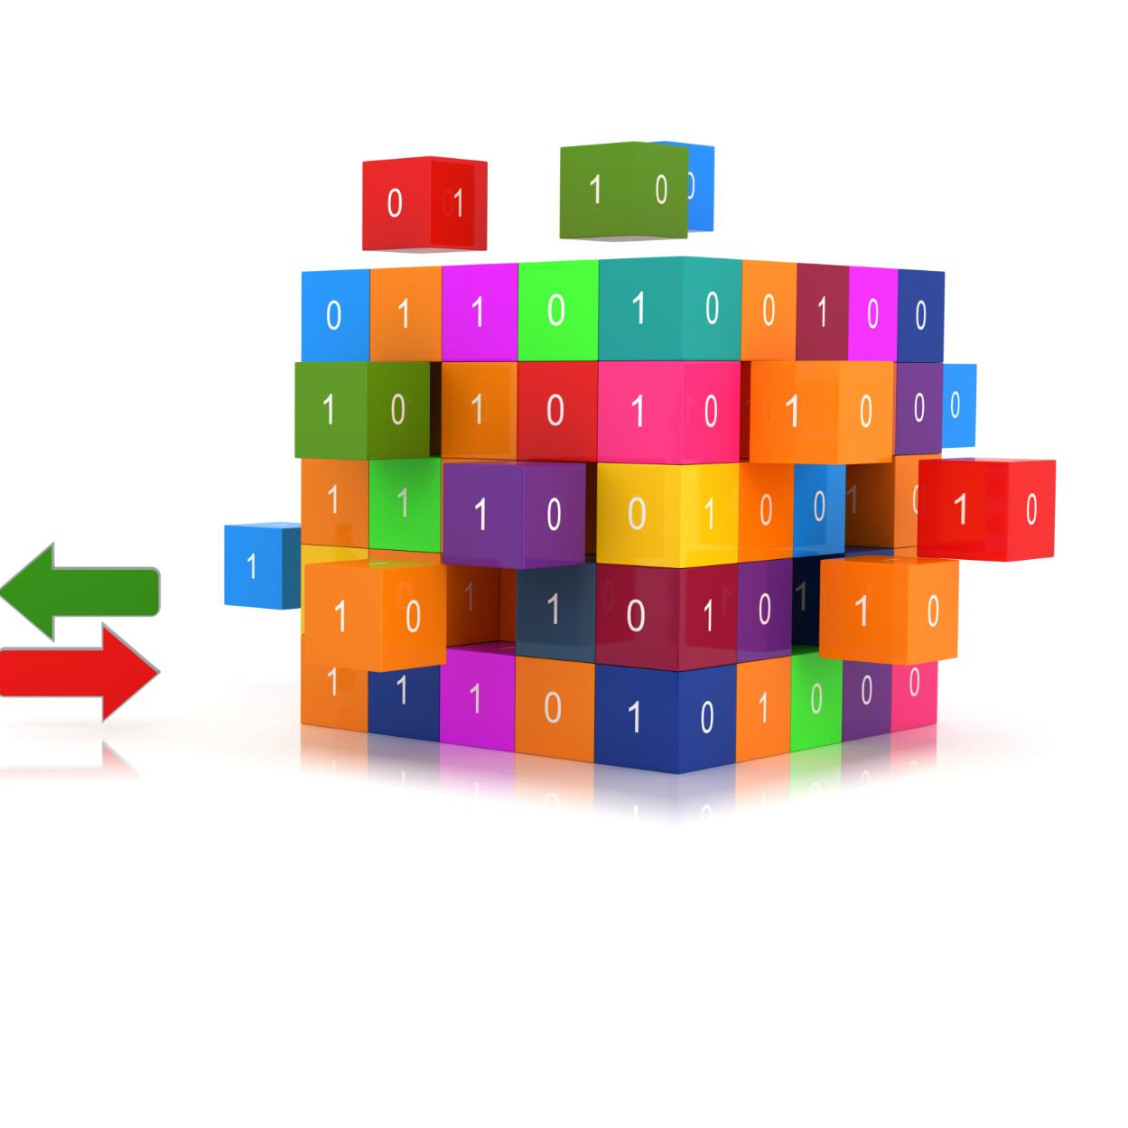
Test Levels
Unit Testing
Unit tests validate pricing, compatibility logic, and individual services in isolation to ensure their correctness.
API and Service Testing
Tests at API and service levels ensure proper functioning of catalog, orders, inventory, and payment services.
Integration Testing
Integration tests verify boundaries between frontend, API gateways, backend services, and warehouse systems.
End-to-End and Regression Testing
End-to-end tests simulate customer journeys; regression tests check cross-service workflows for potential issues.
Notes:
The test levels cover unit tests that validate pricing, compatibility logic, and services in isolation. API and service-level tests ensure correct behavior in catalog management, order processing, inventory synchronization, and payment interactions. Integration tests verify essential boundaries, such as interactions between the frontend and API gateway or between backend services and warehouse systems. End-to-end tests focus on full customer journeys, including browsing, configuring accessories, placing orders, and making payments. Nightly regression tests stress cross-service workflows to identify issues in stock handling, discount rules, or payment edge cases.

Slide 7
Boundaries & Scope
Notes:
Test Object Boundaries

Slide 8
Test Object Boundaries
Test Object | Test Level | When | Env
Web UI (React SPA) | Unit / Integration | PR, nightly | local, preview
API Gateway / BFF | Unit / API | PR, deployment | local, preview
Catalog Service | Unit / API / Integration | PR, deployment, nightly | local, preview, stage
Order & Checkout Service | Unit / API / Integration | PR, deployment, nightly | local, preview, stage
Inventory Sync Service | API / Integration | deployment, nightly | preview, stage
Compatibility Rules Engine | Unit / API | PR, deployment | local, preview
Payment Provider Integration | Integration / E2E | deployment, nightly, release | preview (mock), stage
Warehouse Integration | Integration / E2E | nightly, release | preview (mock), stage
Notes:
The scope of testing is distributed across key system components, including the web storefront, API gateway, catalog services, order and checkout processes, inventory synchronization functions, compatibility rules engines, and integrations with external payment and warehouse providers. Each component has a dedicated test level aligned with realistic execution timing and environments: pull-request level, deployment triggers, nightly runs, or release validation. The environments span from local development and preview deployments with mocked services to production-like staging conditions.

Slide 9
Test Lifecycle
Notes:
Lifecycle Overview

Slide 10
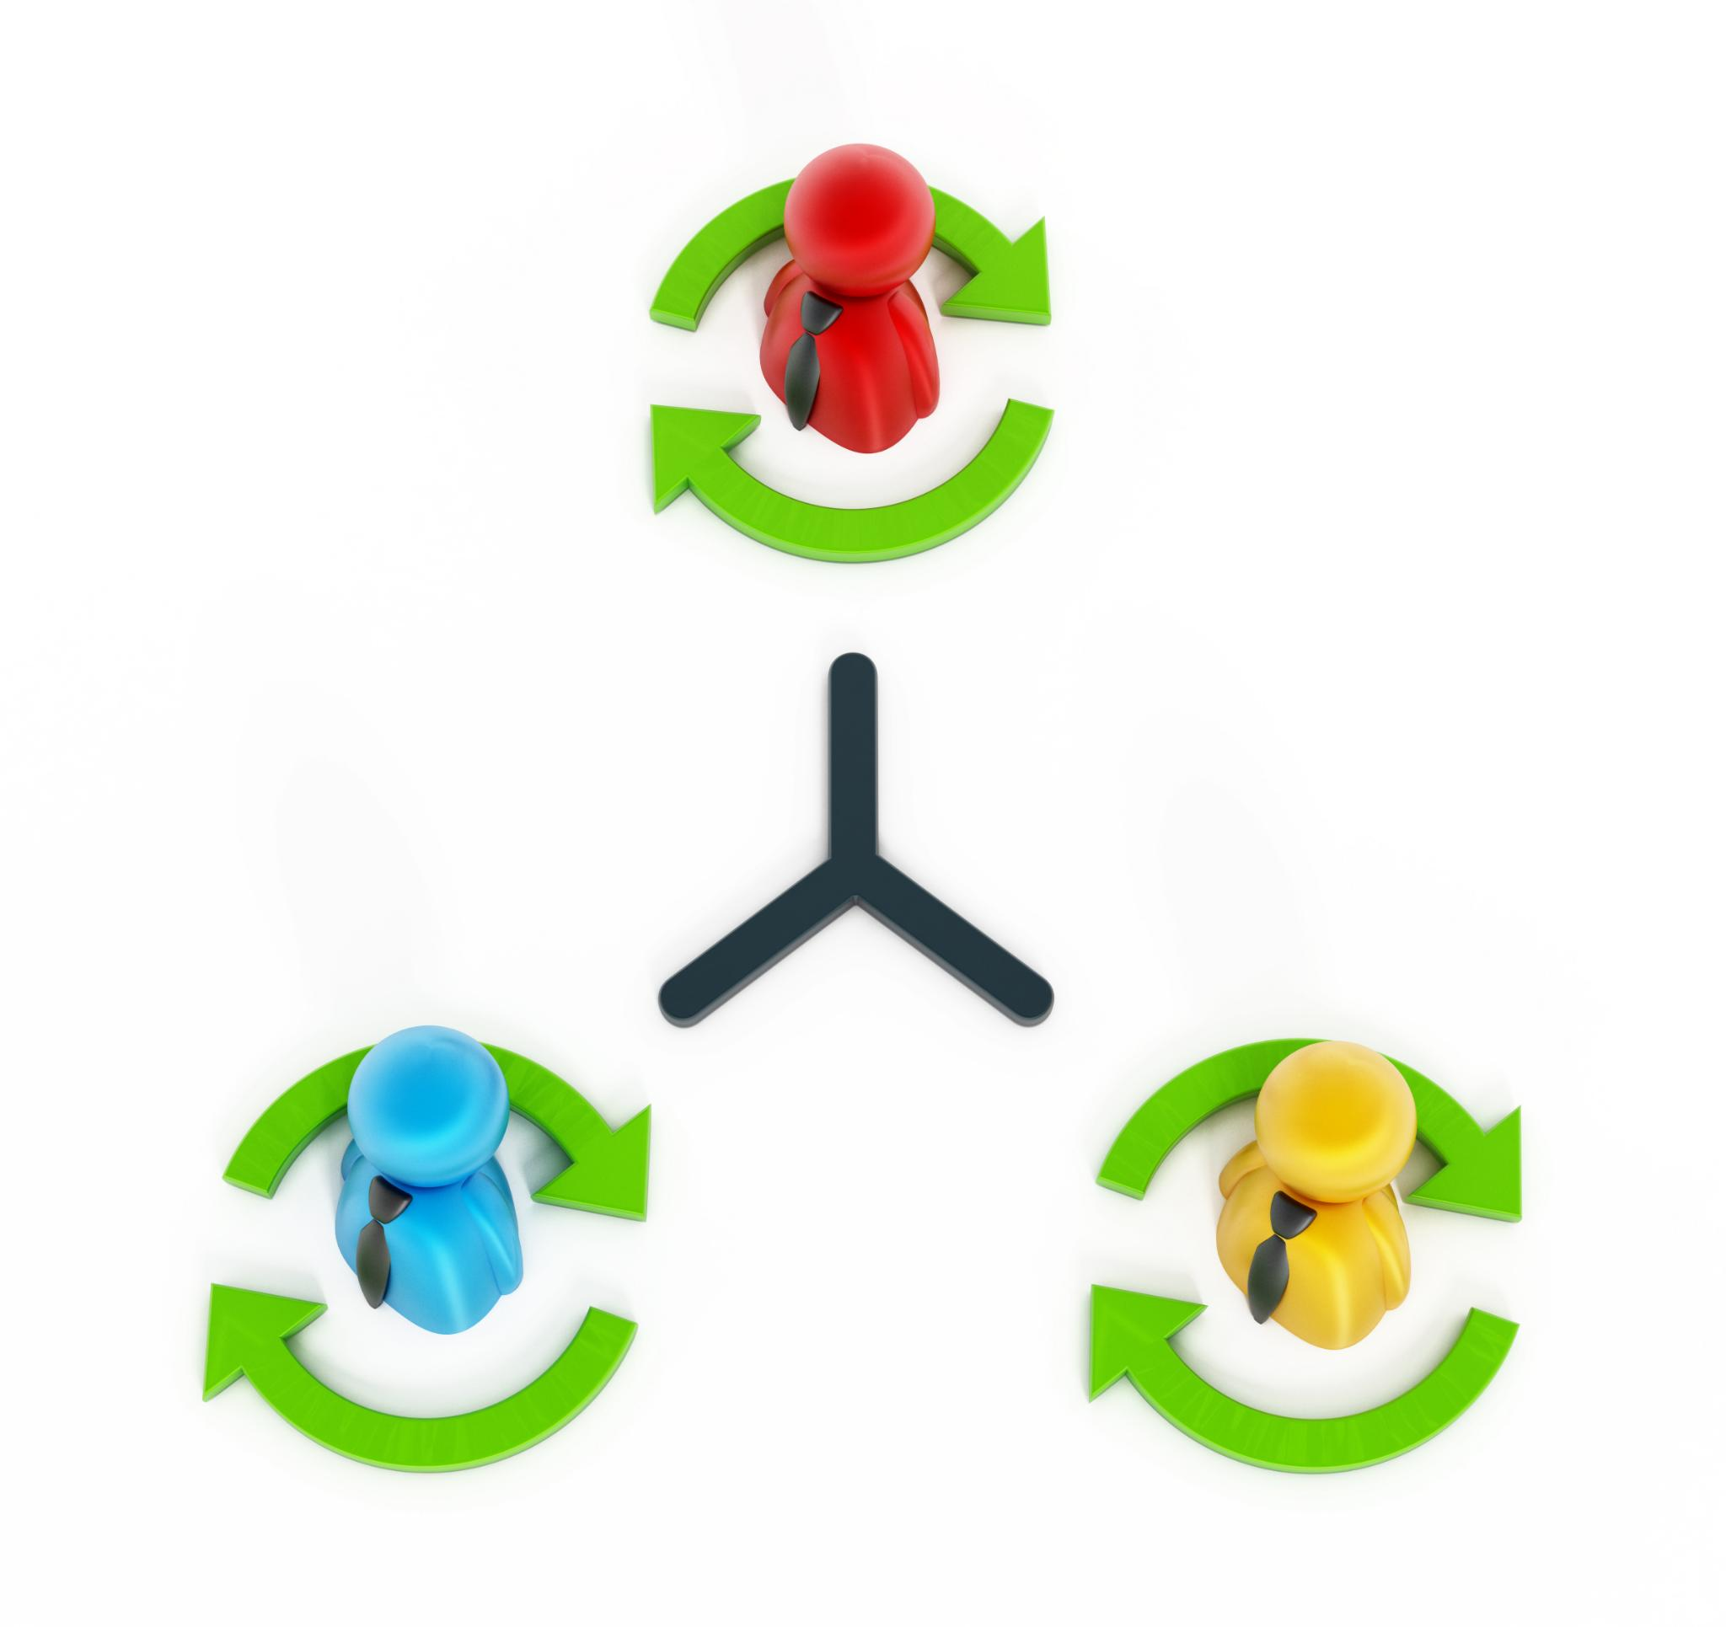
Lifecycle Overview
Scope Definition
Defines service logic, API boundaries, and critical value flows by developers, SDETs, QA, and product owners.
Test Development
Developers build unit and API tests while SDETs create component and end-to-end test scenarios.
Analysis and Troubleshooting
Teams analyze failures to find defects and use mocks for rapid debugging of lower-level issues.
Test Maintenance
Focuses on stabilizing tests and updating data or flows for broader test coverage and fast feedback.
Notes:
The test lifecycle begins with scope definition, where developers and SDETs identify relevant service logic and API boundaries while QA and product owners outline critical value flows. During test development, developers create unit and API tests while SDETs build component and end-to-end scenarios. In the analysis phase, teams interpret failures to identify logic defects, UI/API mismatches, or integration issues. Test maintenance involves stabilizing fast feedback tests and updating data or flows for broader test layers. Troubleshooting uses mocks for rapid debugging at lower levels while addressing deeper defects in end-to-end or regression stages.

Slide 11
CI/CD Testing Flow
Notes:
Continuous Delivery Quality Gates

Slide 12
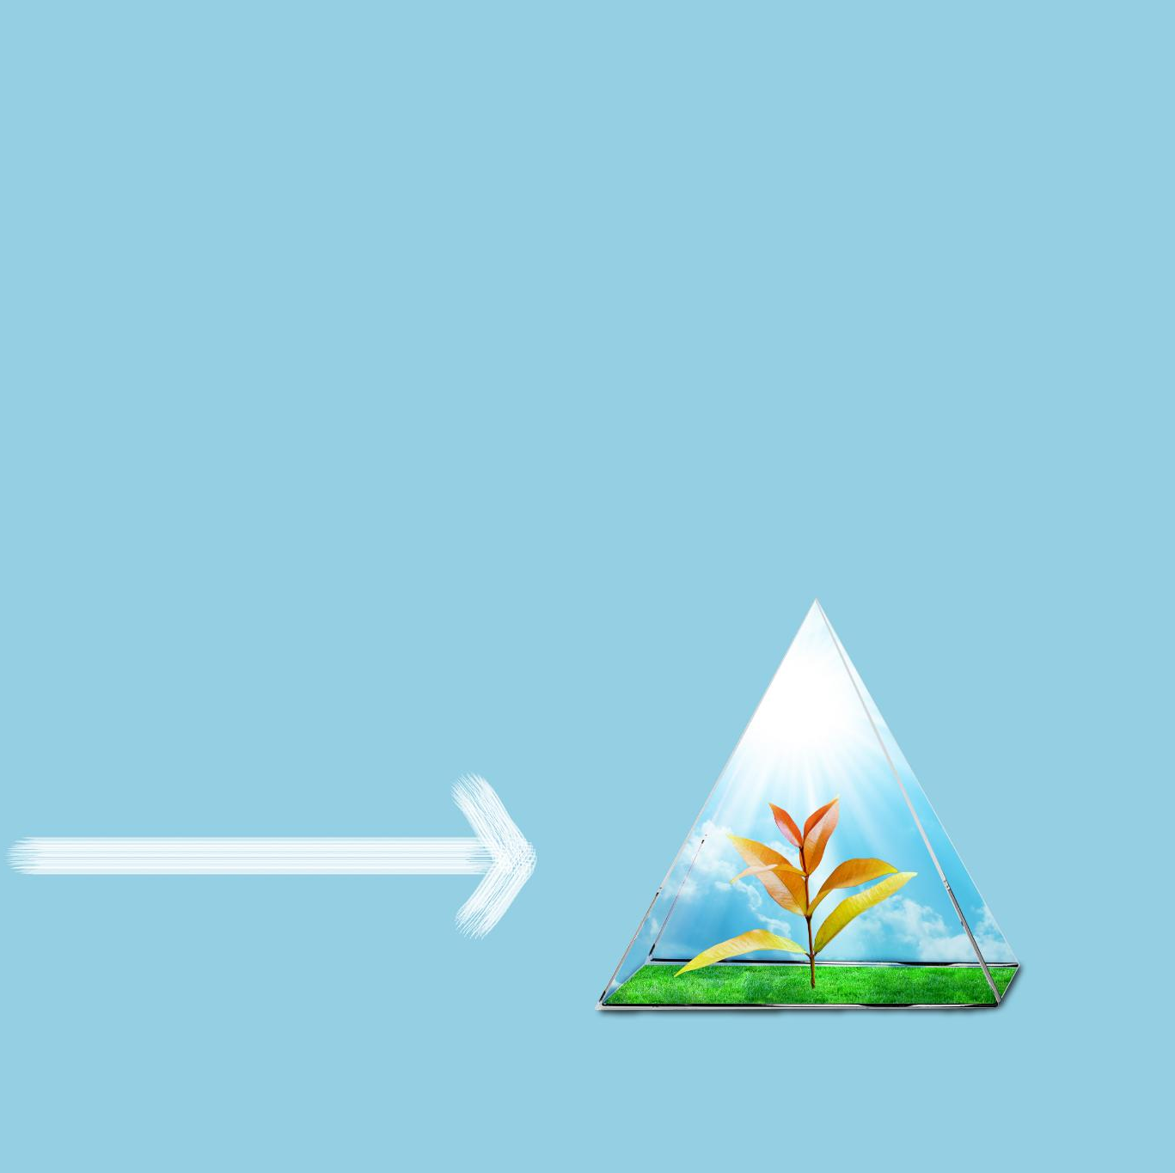
Continuous Delivery Quality Gates
Early Stage Testing
Feature branch testing includes unit, API, and component tests for quick validation of new code.
Integration and Preview Testing
Preview environments allow integration tests using mocked services and light UI flow validations.
Regression and Synchronization Tests
Stage branch triggers broad regression testing and inventory synchronization for system consistency.
Final Validation and Deployment
Telemetry-based health checks in main branch ensure system stability before final production deployment.
Notes:
Throughout the CI/CD pipeline, validations are layered across environments and triggered at specific stages. In the feature branch, unit, API, and component tests ensure fast validation. Preview environments enable integration testing with mocked external services and light UI flows. The stage branch triggers broader regression and inventory synchronization tests. The stage environment hosts nightly regressions and full end-to-end validation, confirming rule engine behavior and payment/warehouse integration. Final deployment to the main branch relies on telemetry-based checks, ensuring system health before release.

Slide 13
Delivery Approach
Notes:
Delivery Flow

Slide 14

Delivery Flow
Collaborative Requirement Refinement
QA, developers, and product owners collaborate to identify risks in pricing, compatibility, payment, and inventory updates.
Incremental Development and Testing
Development advances in small slices with unit and API tests, while SDETs create higher-level automated test scenarios.
Preview and Staging Validation
Preview deployments validate mocked integrations before staging, which performs full regression and end-to-end validation of rule-engine workflows.
Release and Telemetry Review
Critical issues can block deployment; post-release telemetry is reviewed in production-readonly environments to ensure value flow.
Notes:
Delivery begins with collaborative requirement refinement involving QA, developers, and the product owner to identify risks in pricing, compatibility, payment processing, and inventory updates. Development proceeds in small slices supported by unit and API tests, while SDETs prepare higher-level automated scenarios. Preview deployments facilitate mocked-integration validation before staging. The staging environment acts as the main quality gate with full regression and end-to-end validation of real rule-engine workflows. Prior to release, only critical issues affecting value flows can block deployment, followed by telemetry review in production-readonly environments.

Slide 15
Bug Management
Notes:
Bug Workflow Diagram

Slide 16
Bug Workflow Diagram
Step | Description
Bug Reported | Initial capture of functional or integration defects
Triage | QA and PO assess severity and risk relevance
Fix | Developer resolves validated defects
Verification | QA/SDET confirm issue resolution
Promote to Stage | Validated code progresses to staging environment
Release Decision | PO and QA determine release readiness
Notes:
Bug management follows a structured flow beginning with bug reporting, followed by triage performed jointly by QA and the product owner, ensuring severity aligns with risks in pricing, claims, or partner APIs. Developers address confirmed defects, after which QA or SDETs verify fixes before promoting changes to the staging environment. Final release decisions consider the presence of critical issues in value-critical flows. This systematic workflow strengthens quality control across environments.

Slide 17
Definition of Done
Notes:
Quality Criteria Diagram

Slide 18
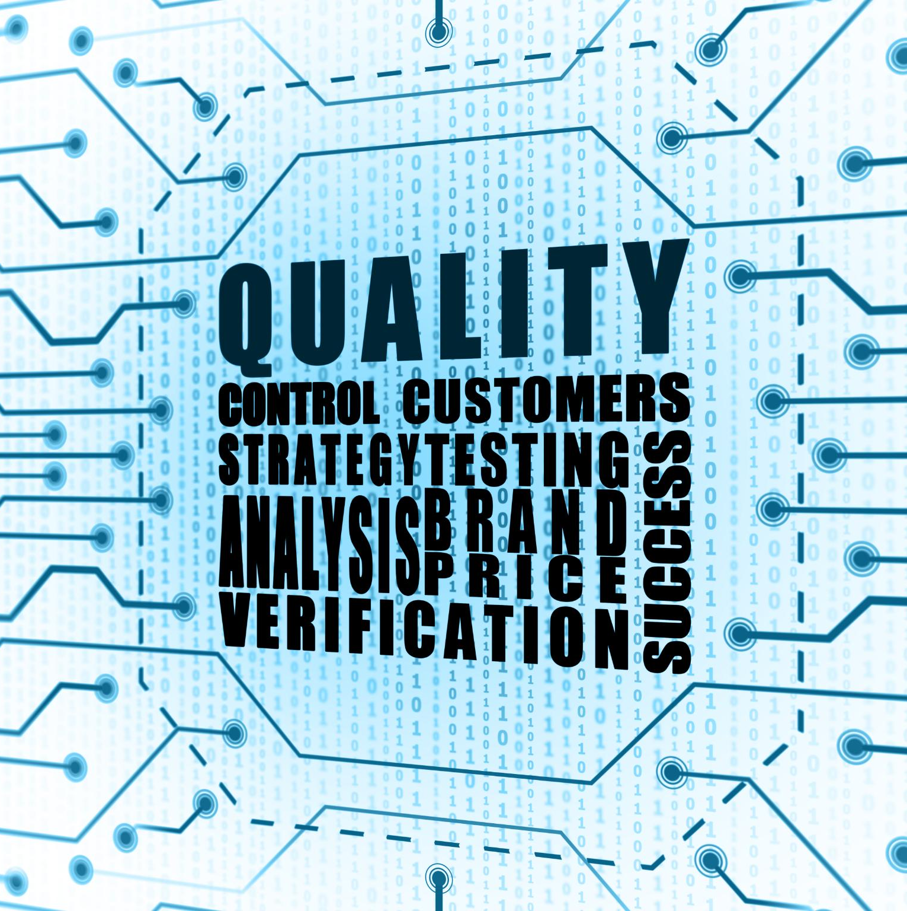
Quality Criteria Diagram
Pricing and Claims Correctness
Pricing and claims logic is validated with unit and integration tests ensuring accurate and consistent results.
Partner API Stability
Partner API interactions must be stable and adhere strictly to contract requirements to maintain integration reliability.
Overall Quality Gates
Automated quality gates, observability instrumentation, and user experience reviews ensure production readiness and timely deployment.
Notes:
The Definition of Done encompasses three primary quality pillars: pricing and claims correctness, partner API stability, and overall quality gates. Pricing and claims logic must be validated through unit and integration tests to ensure consistent and correct outcomes. Partner API interactions must demonstrate stability and contract adherence. Quality gates require automated checks across all affected value flows, green pull request pipelines within time constraints, user experience reviews when relevant, and observability instrumentation for production readiness.

Slide 19
Metrics
Notes:
Testing & Quality Metrics

Slide 20

Testing & Quality Metrics
Quality Signals Metrics
Track pass rates for pricing and claim tests, API failure rates, defect leakage, and rule-engine errors.
Testing Efficiency Metrics
Measure pipeline duration compliance, test flakiness, failure isolation time, and automated coverage of high-risk flows.
Production & Regression Metrics
Monitor error rates, incident frequency, staging regression stability, and integration performance via telemetry.
Notes:
Key metrics span three domains: Quality Signals, Testing Efficiency, and Production & Regression metrics. Quality signals track pass rates for pricing and claim-decision tests, partner API failure rates, defect leakage between environments, and rule-engine error frequency. Testing efficiency metrics include pull request pipeline duration compliance, test flakiness rates, mean time to isolate pipeline failures, and automated coverage of high-risk flows. Production and regression metrics measure error rates in pricing and claims, incident frequency across value flows, nightly staging regression stability, and performance of external integrations observed via telemetry.

